Slide 1
PUBG Win Points Prediction with Spark
Ailun Zhu
az8ec
Notes:
Data preparation
Visualization
Feature engineering
Modeling
LM
RF
Xgboost
…
Business insights & applications
Next steps

Slide 2
Motivation – Business Interest
eSports
the Next Billion-dollar Industry
PUBG
Most Popular Game in 2017
2
billion
By 2020
696 million
In 2018
385 million
In 2018
2 million
Download/month
+500 million
revenue
How Data Science Is
Revolutionizing the Future of eSports
Identify players’ strengths
Predict opponents’ strategies
Build up dream teams
Attract capital and talent
Online gambling and betting

Slide 3
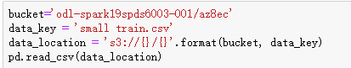
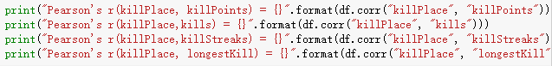
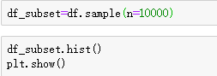
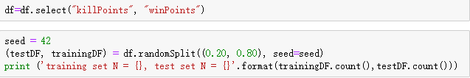
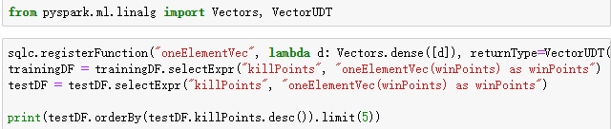
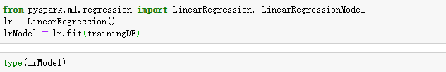
Code Snippet
Load Data & Visualization
Machine Learning Pipeline
Vectorization
Modeling

Slide 4
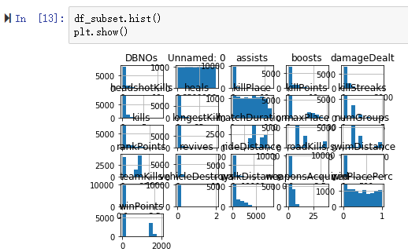
Visualization
Notes:
Allyn

